Slide 1
PowerShell Flow Control
Scripting Essentials
Dr. Burkman

Slide 2
PowerShell Basics

Slide 3
PowerShell
We will use 64 bit PS and PS ISE (not x86)
$PSVersionTable
PowerShell.exe is the text command window
PowerShell ISE is the scripting environment
Right click the icon as run as administrator
Increase font with ctrl + mouse wheel or with slider in lower right of screen
ISE is really where we want to be to build scripts

Slide 4
Running this at home
If you run PowerShell on your own box you may find that you can’t run scripts.
Get-ExecutionPolicy
Set-ExecutionPolicy unrestricted
Obviously be smart about this. You just opened your machine to run any PowerShell code from any source, and there are a lot of modern hacks using PowerShell. So either do this on a junk machine (or play VM) or restrict the policy when done with coursework
Windows PowerShell has four different execution policies:
Restricted - No scripts can be run. Windows PowerShell can be used only in interactive mode.
AllSigned - Only scripts signed by a trusted publisher can be run.
RemoteSigned - Downloaded scripts must be signed by a trusted publisher before they can be run.
Unrestricted - No restrictions; all scripts can be run.
From: https://www.mssqltips.com/sqlservertip/2702/setting-the-powershell-execution-policy/

Slide 5
ISE
Feels a bit like IDLE
Script Editor pane
Console pane
Commands Explorer
Tab auto-complete
In console, type Get-S and hit tab a few times
Both autocompletion and Intellisense (the menu)
Try dir C:\ and tabs
Up arrow for previous commands

Slide 6
ISE
Update help with Update-Help
This is essential
You must be Administrator
Invoke help with help or man
Help while
Man while
Clear
Clears the console
Help *log* or help *event* to get a list of possible relevant help topics
Get-Command *firewall* to get PowerShell (and windows) commands
Try: help about

Slide 7
ISE
Get-EventLog system
Get-EventLog –List
Get-EventLog Application > C:\Users\Burkman\Desktop\events.txt
> and >> work just like in BASH
cmdlets are verb/noun pairs
Can create a transcript of everything you do in PS session
Start-Transcript
Stop-Transcript

Slide 8
ISE
You have access to the .net built in classes like Math.
$dog = [math]::abs($cat)
Can use piping
Get-Process | Where-Object { -not $_.Responding }
Get-Process | Where-Object PriorityClass –eq “Normal”
Get-Content "C:\Users\Burkman\Desktop\events.txt " | select -First 10 | Out-File "C:\Users\Burkman\Desktop\toptenevents.txt"

Slide 9
PowerShell Flow Control

Slide 10
PowerShell Flow Control
Some basics:
How variables are denoted (hint: about_variables)
Put a $ in front of the variable name
How to pause
Break and continue as normal
$true and $false for booleans
+ and * work just like in Python
Read-Host -Prompt "Press enter to close the program"

Slide 11
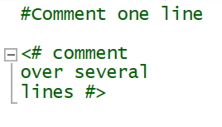
PowerShell Flow Control
Comments:

Slide 12
PowerShell Flow Control
User input and printing to console. Use Write-Host for printing to the console:
$dog = Read-Host -Prompt "Please enter a word"
Write-Host $dog
Write-Host "This is $dog"
#There is also Write-Output, which allows the output to be redirected
Write-Output $dog > C:\Users\Burkman\Desktop\dog.txt

Slide 13
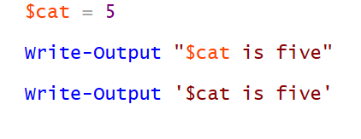

Quotes
Single quotes are literal, double quotes allow for variable unpacking:

Slide 14
PowerShell Flow Control
Getting random values
clear
$myRan = Get-Random -Minimum 10 -Maximum 20
Write-Host $myRan
Read-Host -Prompt "Press any key to continue"
This will only get up to 19. The minimum is included, the maximum is not.

Slide 15
Note
Examples throughout these slides are excerpts from the Windows PowerShell Cookbook
Nice links:
https://akr.am/blog/posts/a-python-developers-guide-to-powershell
Note: his PS XKCD example is broken
http://blogs.lessthandot.com/index.php/datamgmt/dbprogramming/a-cheat-sheet-for-all/
PowerShell is C# - ish, so think in term of braces and you’ll be fine

Slide 16
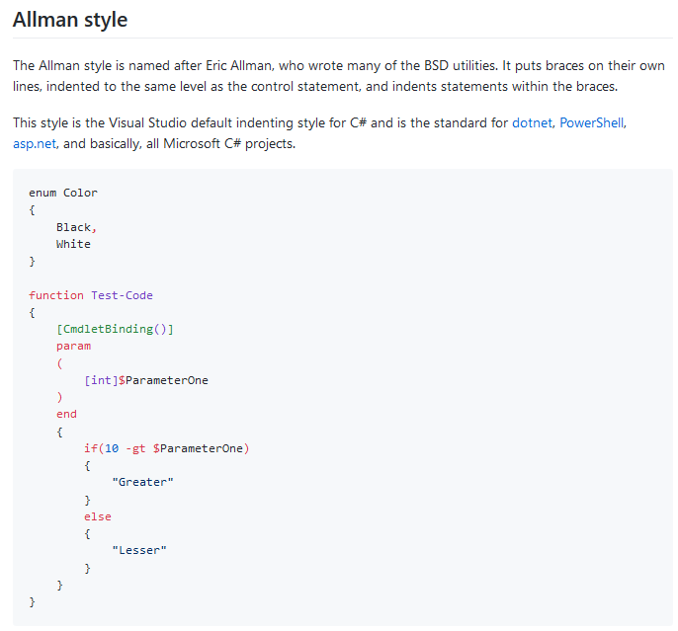
https://github.com/PoshCode/PowerShellPracticeAndStyle/issues/81

Slide 17
Bash-like Comparisons
Comparison operators
-eq , -ne , -ge , -gt , -in , -notin , -lt , -le , -like , -notlike , -match , -notmatch ,-contains , -notcontains , -is , -isnot (put c in front to make case sensitive, like –ceq)
Logical operators -and , -or , -xor , -not

Slide 18
If statement
if, elseif, and else Statements
if(condition)
{
statement block
}
elseif(condition)
{
statement block
}
else
{
statement block
}

Slide 19
IF Example (with While)
clear #This clears the output screen
while ($true) #while works like we already know with break and continue
{
$ans = Read-Host -Prompt "Enter an integer"
if ($ans/1 -gt 10) #$ans/1 forces the input to be an integer
{
write-host "big"
}
else
{
Write-host "small"
}
}

Slide 20
Try/Catch
while ($true)
{
$ans = Read-Host "Enter a number"
try
{
$ans -eq $ans/1 | Out-Null
}
catch
{
Write-host "oops"
continue
}
if ($ans/1 -is [int])
{
write $ans
break
}
else
{
write-host "$ans is not an integer"
continue
}
}

Slide 21
For Statement
help about_For
for (<init>; <condition>; <repeat>)
{<statement list>}
for($i=1; $i -le 10; $i++)
{
Write-Host $i
}

Slide 22
For Statement
clear
for ($i = 30; $i -gt 10; $i--)
{
Write-Host $i
}
#This is like looping through a range in Python

Slide 23
Foreach Statement
Help about_Foreach
$dog=(1,2,3,'a','b','c')
foreach ($cat in $dog)
{
Write-Host($cat)
}

Slide 24
Helpful Miscellanea
Backtick is used to escape. That’s above the tab key on most keyboards.
Outputting text with an additional line feed:
You can exit the script with exit.
Write-host("Welcome to the Favorite Zone `r`n")

